Slide 1
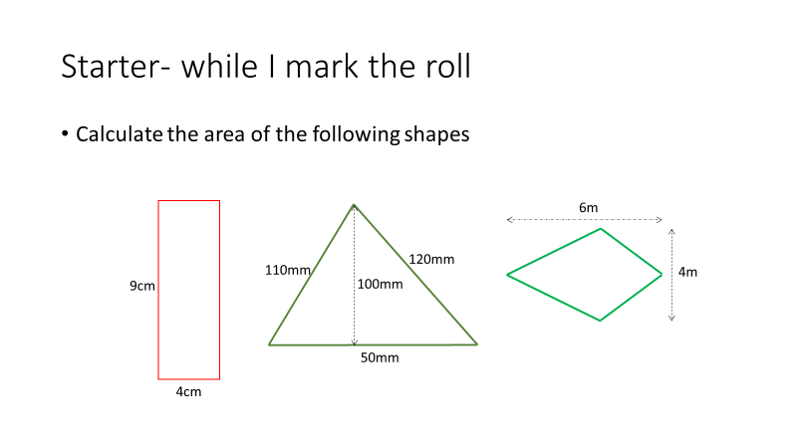
6 Minute Revision Starter- work with shoulder partner
Notes:
hook

Slide 2
Topic: Total Surface Area
EQ: How do you calculate the total surface area of a prism?

Slide 3
Learning Intentions
Students will be able to
- determine the difference between 2D and 3D shapes
use area rules of shapes to find the total surface area of a 3 D shapes

Slide 4
24
7
30
Date
Total Surface Area
EQ – How do you calculate the total surface area of a prism?
5
Notes:
Lesson objective (EQ)

Slide 5
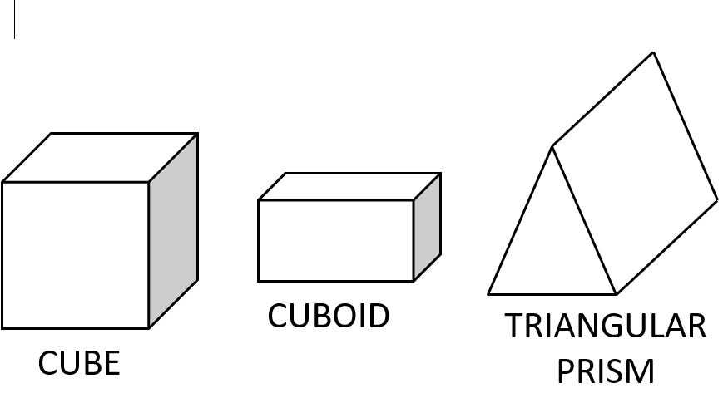
24
7
30
Date
Surface Area
EQ – How do I calculate the surface area of a prism?
A prism is a 3D shape that has a constant cross-section.
Total Surface Area (TSA) is the sum of the areas for each face of the 3D object
5
Notes:
Input

Slide 6
Teacher notes: Use slide 7 as notes
Now set up 2 column notes to show working out of the following examples
In pairs:
Talk about the faces and how to find the area of each face and then how to find the total surface area of the whole prism
Use cubes and rectangular prisms boxes and rulers to calculate a real life examples

Slide 7
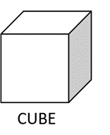
24
7
30
Date
Total Surface Area
EQ – How do you calculate the total surface area of a 3D object
For each 3D shape you need to break it down.
For example a Cube
a cube has 6 faces
Front/back
Top/Bottom
Left/Right
You need to calculate the area for each face then add the 6 area’s together to get the Total Surface Area (TSA)
Rectangular Prisms also have 6 faces
5
Notes:
Use packaging boxes to demonstrate the faces

Slide 8
Now you have had a go of measuring and calculating the TSA of a real packaging box, Let’s do this one together to make sure you are showing detailed communication
TSA of a rectangular prism or cube
6m
7m
8m

Slide 9
Cut the box up into its 6 faces
8m
Front & Back.
6m
2 of these, so SA
= 2 × 8 × 6 = 96 m²
8m
Top & Bottom.
7m
2 of these, so SA
= 2 × 8 × 7 = 112 m²
7m
Left & right.
6m
2 of these, so SA
= 2 × 6 × 7 = 84m²
TSA = 96 + 112 + 84 = 292m²

Slide 10
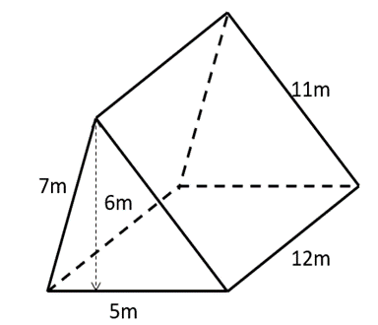
24
7
30
Date
Total Surface Area
EQ – How do you calculate the total surface area of a prism
A triangular prism has 5 faces
Front/back which are triangles
3 sides that are rectangles.
With some prisms using ‘shape nets’ can make it easier to identify the dimensions of each of the faces, triangular prisms are one of these shapes.
5
Notes:
Lesson objective (EQ)

Slide 11
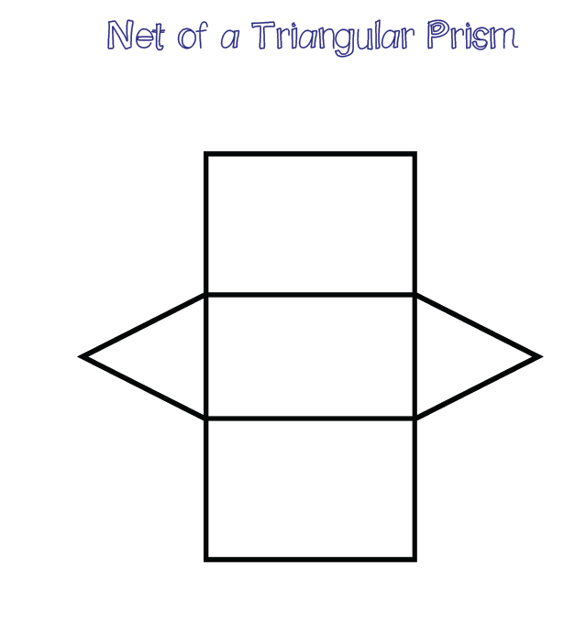
24
7
30
Date
Total Surface Area
EQ – How do you calculate the total surface area of a 3D object
Shape net of a Triangular prism
Clearly shows the areas that need calculating
Once drawn transfer the measurements and then calculate your areas.
5
Notes:
From the previous slide write the measurements onto the net so the students can see how to transfer the measurements.

Slide 12
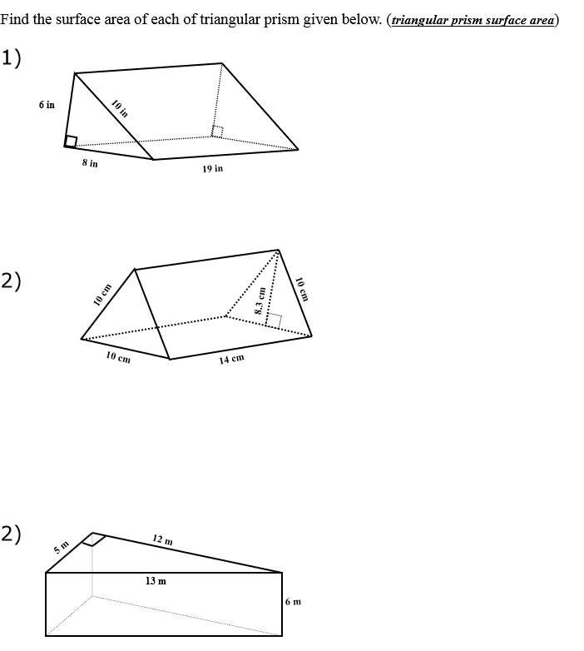
Activity
Notes:
Independent practice

Slide 13
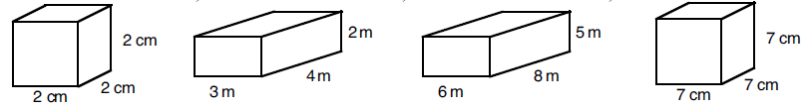
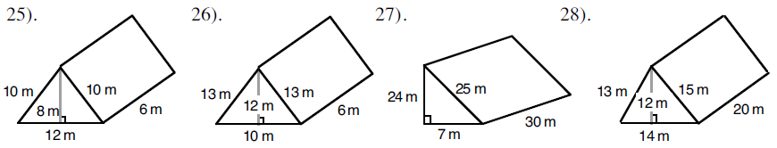
1.
2.
3.
4.
5.
6.
7.
8.
9. Katy wants to wrap a present that is 15cm wide, 18cm deep and 4cm high. How much wrapping paper will she need to use?
10. A length of copper piping is in the shape of a triangular prism. The triangle on it’s end is 9mm tall, 4mm wide. The piece of pipe is 18cm long. What is the surface area of the pipe?
11. A box has no lid. The box measures 1.2m by 30cm by 45cm. What is the surface area of the outside of the box?

Slide 14
Surface Area of Prisms
Area of Parallelograms
= 9 x 7
= 63cm²
Area of Rectangles 1
= 11 x 9
= 99cm²
99 x 2
= 198cm²
Area of Rectangles 2
= 8 x 11
= 88cm²
88 x 2
= 176cm²
TOTAL SURFACE AREA
= 63 + 198 + 176
= 437cm²
7cm
8cm
11cm
9cm

Slide 15
Surface Area of Prisms
6cm
TOTAL SURFACE AREA = 56 + 128 + 160 + 128 + 96
= 568cm²
8cm
7cm
8cm
16cm
Area of Trapeziums = ½ (10 + 6) x 7
= ½ x 16 x 7
= 56cm²
10cm
Area of Rectangle 1 = 16 x 8
= 128cm²
Area of Rectangle 2 = 10 x 16
= 160cm²
Area of Rectangle 3 = 16 x 8
= 128cm²
Area of Rectangle 4 = 6 x 16
= 96cm²

Slide 16
Find the surface area of the following shapes
6m
4cm
5m
4m
3cm
7cm
9m
5m
7cm
8cm
11cm
9cm

Slide 17
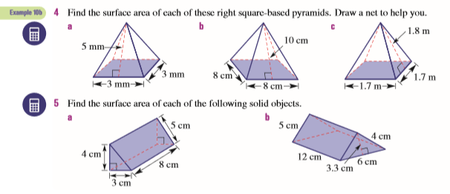
Activity
Notes:
Independent practice

